Slide 1
The Production Function
Module 3 · Video 2
Management 405
Prof. Nico Voigtländer · UCLA Anderson

Slide 2
Module 3 · Agenda
Outline of Module 3
1
Introduction to Module 3
Video 1
2
The Production Function
How inputs (capital and labor) are turned into output
Video 2
3
Short Run: Hiring Decisions
Video 3
4
Wage Searchers
Video 4
5
Long Run: The Optimal Input Mix
Video 5
6
Cost Concepts
Video 6
7
Economies of Scale and Scope
Video 7
Management 405 · Module 3 · Production and Costs
2
Notes:
Let's start with Part 1, Production. The question we're after is straightforward: how does output depend on the inputs a firm uses? We'll take it in two steps. First, short-run hiring, where the plant is fixed and the only question is how many people to hire. Then the long run, where you can choose everything, and the question becomes the right balance of capital and labor. Let's begin with the production function.

Slide 3
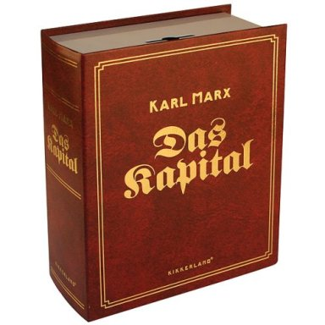
Module 3 · The Production Function
The Production Function
Q = f (K, L, etc)
Q = Output
f = a function of inputs:
K = Capital (physical: factories, machinery, software, IP)
L = Labor
"etc" can be raw materials, energy...
Marx, Das Kapital (1867)
A production function transforms inputs into outputs
The more efficient this process, the higher is productivity
Management 405 · Module 3 · Production and Costs
3
Notes:
Here's the production function in its simplest form. Output, which we call Q, depends on the inputs a firm uses. The two main ones are capital, labeled K, and labor, labeled L, and there can be others too, like raw materials or energy. Let me say a word about capital, because it's broader than it first sounds. It's not just buildings. It also includes machinery, software, and intellectual property, basically anything you've already paid for that keeps producing for you. The line at the bottom sums it up: a production function turns inputs into output, and the more efficiently it does that, the higher your productivity. Productivity is a word we'll keep coming back to, and the rest of the module builds on this one idea.

Slide 4
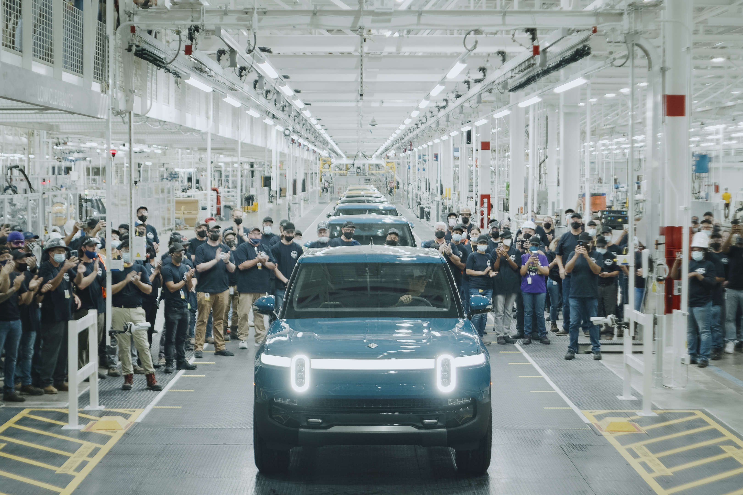

Module 3 · The Production Function
Short vs. Long Run: A Critical Distinction
In the short run, some inputs (fixed factors) cannot be increased or decreased
The long run is a period long enough for all inputs to be variable
Capital fixed in short run
Labor (ophthalmologists) fixed in short run
Rivian Normal, IL plant (CC BY-SA, Wikimedia)
Management 405 · Module 3 · Production and Costs
4
Notes:
Next, let's separate the short run from the long run, because they lead to different decisions. In the short run, some inputs are fixed. We call these fixed factors, and you can't change them within your planning window. The long run is a stretch of time long enough that every input can change. The two photos make this concrete. On the left is Rivian's plant in Normal, Illinois. In any given quarter, the building and the robots are set. Rivian can add shifts and hire more workers, but it can't put up a second factory overnight. On the right is an ophthalmologist. A specialist with years of training is also fixed in the short run, because a hospital can't produce another surgeon in a month. Both cases point to the same idea: in the short run, you work with the things you can't change. That's what we'll do next, starting with the marginal product of labor.

Slide 5
Module 3 · The Production Function
Rivian's Production Function: R1 Line Weekly Output
Number of robots (K)
 | 100 | 200 | 300 | 400
0 | 0 | 0 | 0 | 0
250 | 165 | 234 | 286 | 331
500 | 204 | 288 | 353 | 407
1,000 | 251 | 354 | 434 | 501
1,500 | 283 | 400 | 490 | 566
2,000 | 309 | 436 | 534 | 617
2,500 | 330 | 467 | 571 | 660
3,000 | 348 | 493 | 604 | 697
3,500 | 365 | 516 | 632 | 730
4,000 | 380 | 537 | 658 | 760
4,500 | 394 | 557 | 682 | 787
5,000 | 406 | 574 | 703 | 812
Number of
cars per week
Number of workers (L)
Management 405 · Module 3 · Production and Costs
5
Notes:
This is Rivian's actual production function for their R1 line, laid out as a table. Down the left we vary the number of workers, from 250 up to 5,000. Across the top we vary the number of robots, from 100 to 400. Every cell is the weekly output in cars. Start with the cell I've highlighted, 467. It sits where 2,500 workers meet 200 robots. So with that combination Rivian builds 467 cars a week. That is how you read any cell in the table. Now there are two patterns worth noticing. First, pick a single column, so hold the number of robots fixed, and read down as we add workers. Output keeps rising, but by smaller and smaller amounts. That is the marginal product of labor falling as we add labor. Second, pick a row and read across as we add robots. The same thing happens in the other direction. The marginal product of capital falls too. So output rises both ways, but always at a diminishing rate. Hold onto that pattern. It drives everything we do next.

Slide 6
Module 3 · The Production Function
Plotting Total Output: Q vs. L for the Rivian R1
Management 405 · Module 3 · Production and Costs
6
Notes:
Here are those same numbers as a picture, which makes the pattern much easier to see. Each curve is total output as we add workers, and there is one curve for each level of robots, from 100 at the bottom up to 400 at the top. Look at any one curve on its own. It climbs quickly at first and then flattens out. That flattening is diminishing marginal product of labor, each extra worker adding less than the one before. Now look at the spacing between the curves. As we move from 100 robots to 200 to 300 to 400, the curves bunch closer together. So adding more robots also buys less and less extra output. That is diminishing marginal product of capital. This shape turns up everywhere, from a factory floor to a consulting team, so it is worth getting comfortable with it.

